Slide 1
A YANG Data Model for Microwave Topology draft-ietf-ccamp-mw-topo-yang-04
https://datatracker.ietf.org/doc/html/draft-ietf-ccamp-mw-topo-yang-04
J. Ahlberg (Ericsson)
S. Mansfield (Ericsson) - presenting
M. YE (Huawei)
I. Busi (Huawei)
D. Spreafico (Nokia)
X. Li (NEC)
IETF 115 CCAMP November 2022

Slide 2
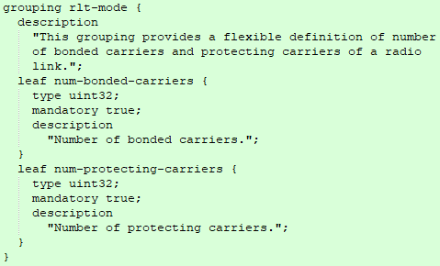
Status
Main changes compared to that previous version
Change to ietf-microwave-topology YANG
Created an “rlt-mode” leaf that provides a flexible definition of the number of bonded carriers and number of protecting carriers of a radio link. Previous version was a simple enumerated list.
Modified instance examples to align with the change

Slide 3
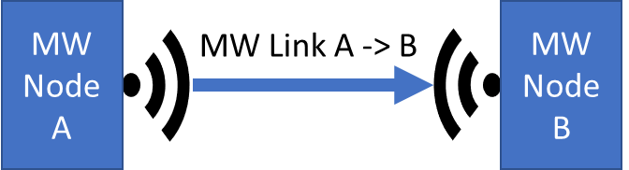
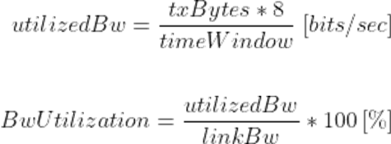
Issue under discussion
Bandwidth Utilization
https://github.com/ietf-ccamp-wg/draft-ietf-ccamp-mw-topo-yang/issues/3
Questions:
How to count txBytes for a microwave link?
How to represent timeWindow?
Where the calculation is done? On the Node? In the Controller?

Slide 4
Plan
Close on Bandwidth Discussion and request working group last call.
Discuss plan for an update to RFC 8561
Discuss still in “individual draft” state
The generic rlt-mode could be added in a bis of RFC 8561
Better encapsulation of microwave radio link characteristics (thus simplifying the microwave topology model)
Other enhancements like Latency, Fade, BER, Power consumption etc. could be explored

